Slide 1

Wave Propagation in Random Media
Ben Payne
Alexey Yamilov
Physics Department

Slide 2
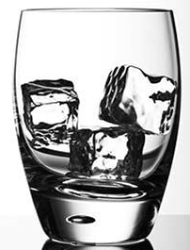
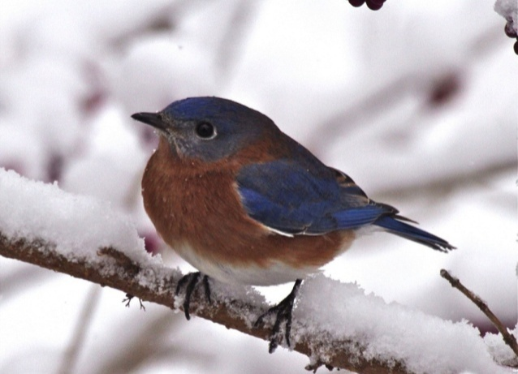
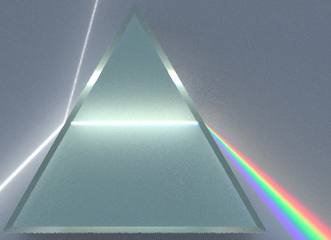
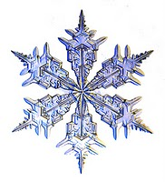
Ice versus Snow
Q: What makes snow white?
A: Light scattered by snowflakes
Q: What makes snow white?
A: All colors scattered the same

Slide 3
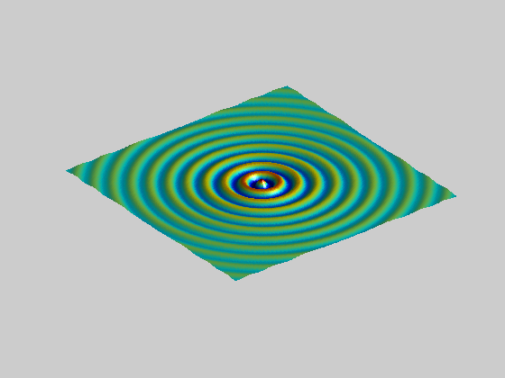
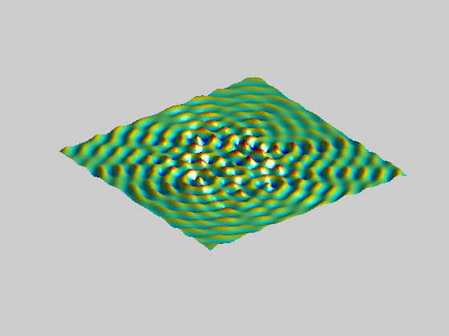
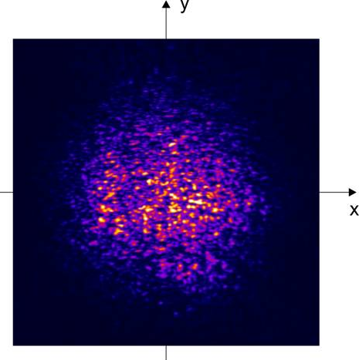
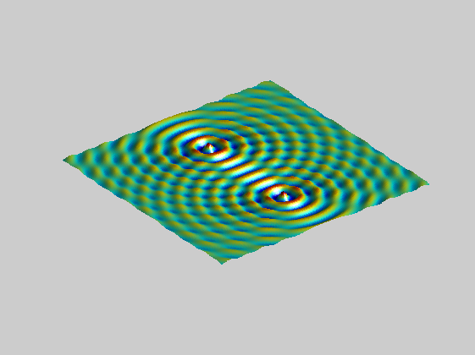
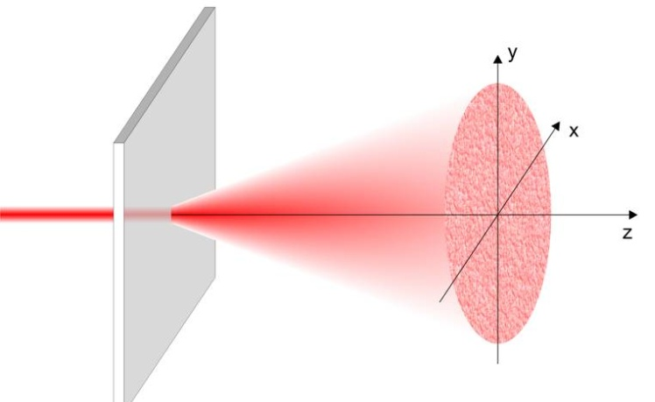
Wave Interference
1 →2→mess

Slide 4
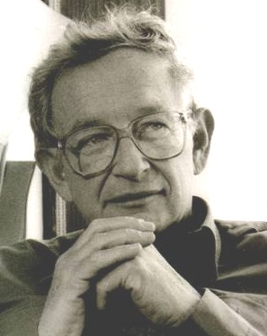

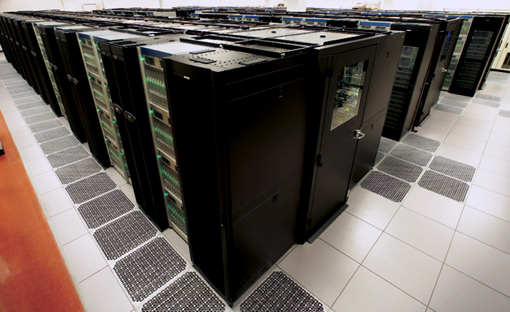
Waves Got Lost
"Localization …, very few believed it at the time, and even fewer saw its importance, among those who failed to fully understand it at first was certainly its author.
… one has to resort to the indignity of numerical simulations to settle even the simplest questions about it.” P.W. Anderson, Nobel Lecture, 1977

Slide 5
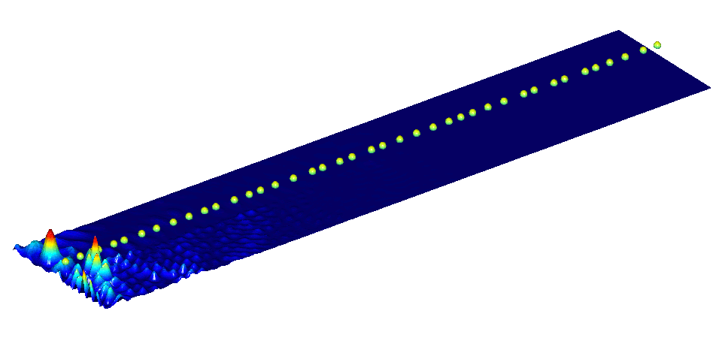
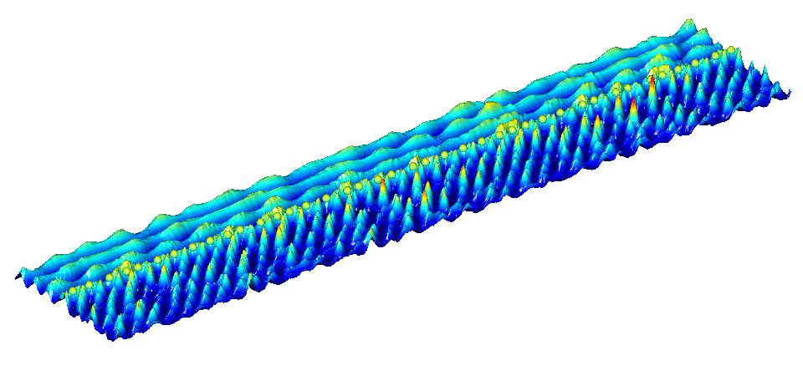
From Chaos to Order
Remember
From
understanding
the fundamentals to
complete control of propagation

Slide 6
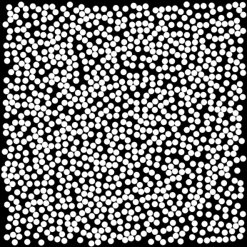
From Observer to Creator
Perfect order
Complete disorder
Design of materials with desired optical properties
Nano-technology makes it possible

Slide 7
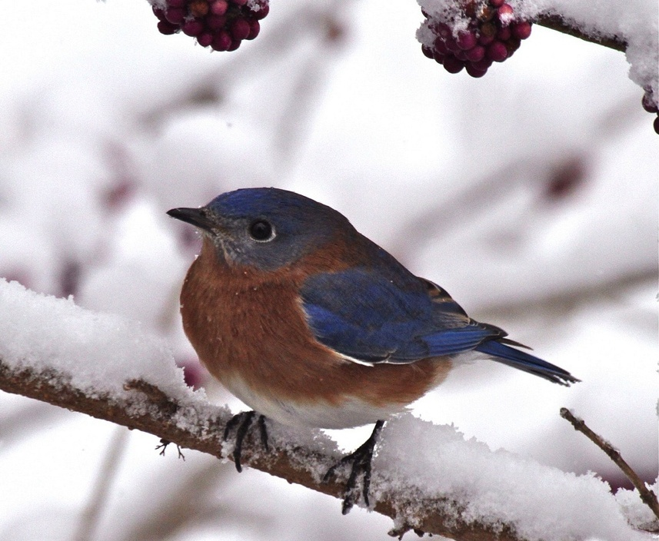
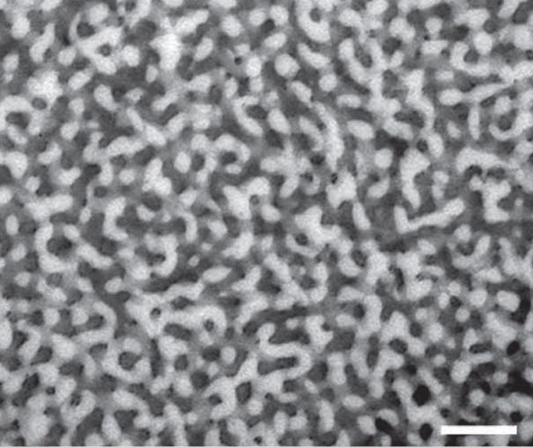
Avian Nano-Technology
Q: What makes bluebird blue?
A: Nano-feather

Slide 8






Who is Who
Jeffrey Jau
Tom Mahler
Mark Herrera
Winston Carr
Laura Sisken
Grant MacDonal
Ben Payne
Sumudu Herath
H. Cao S. Skipetrov E. Chaikina

Slide 9

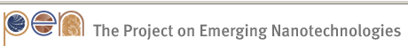
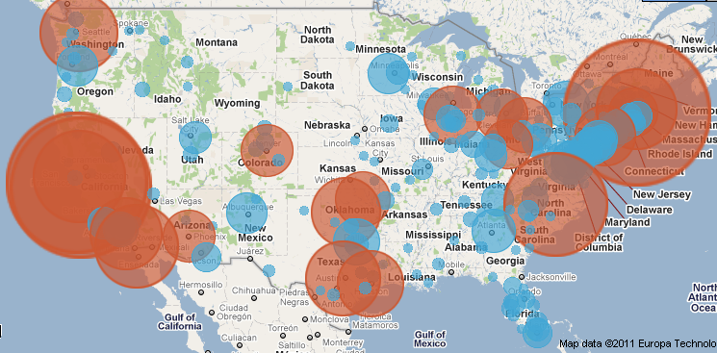
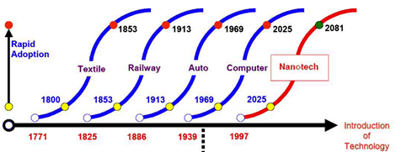
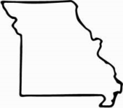
From the Lab to a Classroom
Undergraduate Course:
“An Introduction to Nanotechnology”
via Missouri Alliance for Collaborative Education

